Slide 1

Data Lake Analytics
End-to-End Data Pipeline with Azure Data Factory, ADLS, and Power BI

Slide 2
Agenda
Problem Statement
Introduction
Technologies Used
Architecture Diagram
Conclusion
How It Works
Execution Overview

Slide 3
Problem Statement
Organizations deal with large, diverse, and raw datasets (Excel, CSV, Parquet, Databases).
Lack of structured transformation leads to inconsistent reporting and slow decision-making.
Business needs a scalable, automated, and efficient pipeline for
Data ingestion
Data cleaning & transformation
Business-ready reporting

Slide 4
Introduction
This project demonstrates a Data Lake Analytics solution using Azure services.
The goal is to ingest, transform, and analyze data efficiently.
Data is processed in layers (Bronze, Silver, Gold) for clarity and governance.
Final insights are visualized using Power BI.

Slide 5
Technologies / Azure Resources
Azure Data Factory (ADF) – Orchestration & ingestion
Azure Data Lake Storage (ADLS Gen2) – Centralized storage with Bronze, Silver, Gold layers
Azure Data Flow – Cleansing & transformation
Azure Synapse Analytics – Querying and integration
Power BI – Data visualization and reporting
File Types Used – XLSX, CSV, Parquet

Slide 6
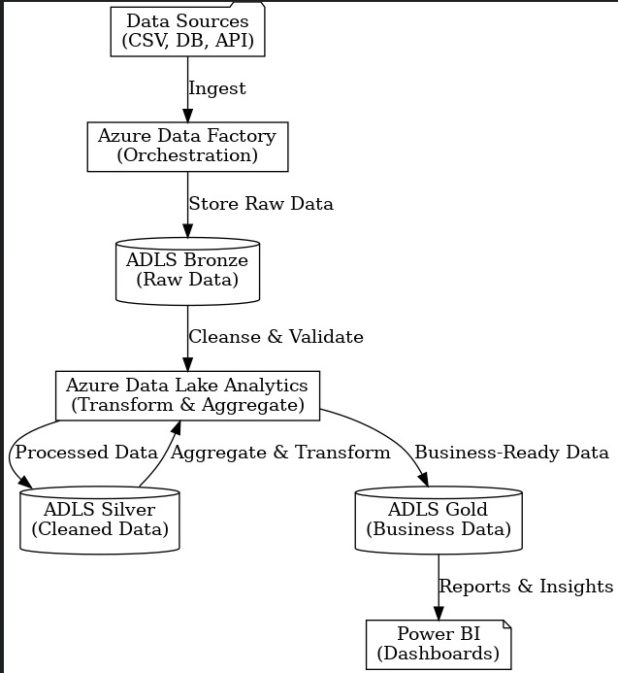
Architecture Diagram
Flow Summary
Source Systems → Azure Data Factory → ADLS (Bronze → Silver → Gold)
Data transformations with Azure Data Flow
Curated data consumed by Synapse Analytics / Power BI

Slide 7
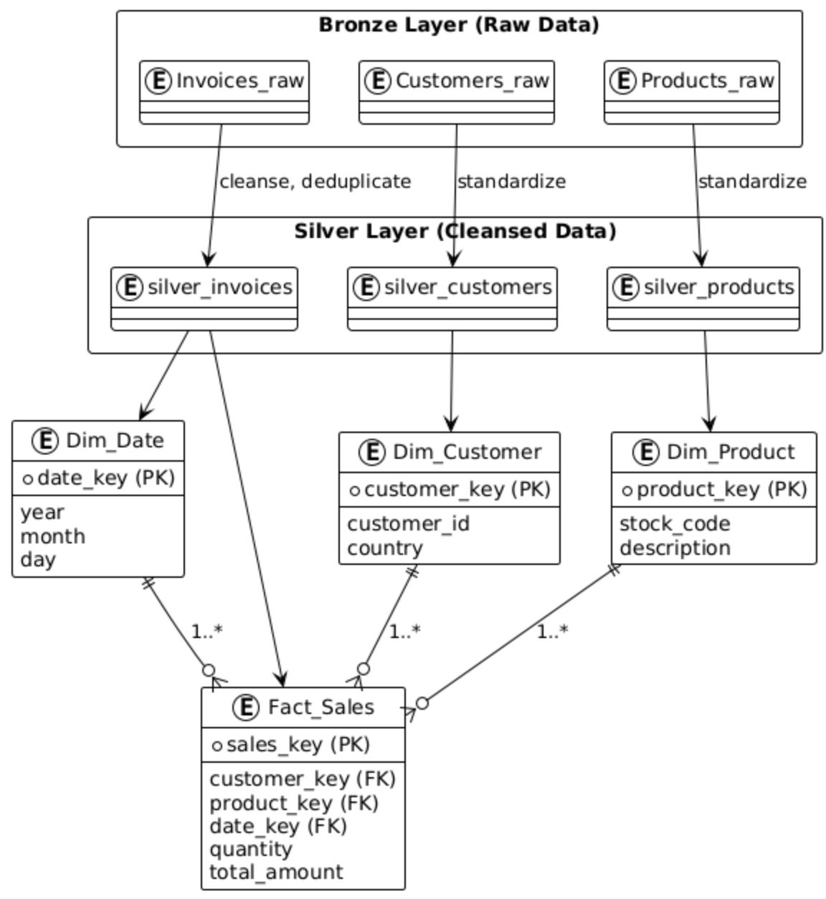
ER Diagram
Entities
Customer (customer_id, name, country)
Product (product_id, stock_code, description)
Sales Fact (invoice_no, date_key, customer_id, product_id, quantity, total_amount)
Date Dimension (date_key, year, month, day)

Slide 8
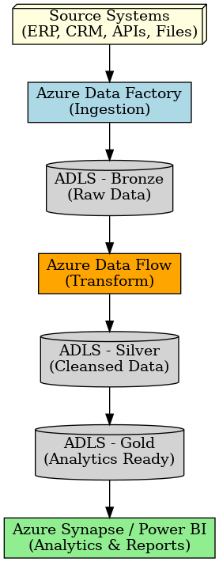
How It Works
Ingestion: ADF collects data from source systems (XLSX, CSV, Databases).
Bronze Layer: Raw unprocessed data stored in ADLS.
Transformation: ADF Data Flows clean, validate, and join datasets.
Silver Layer: Standardized, cleansed data stored in ADLS.
Aggregation & Business Rules: Curated tables created.
Gold Layer: Final, business-ready datasets.
Analytics: Power BI consumes Gold data for dashboards.

Slide 9
Execution Overview
Data ingestion pipeline executed successfully.
Raw files landed in ADLS Bronze.
Azure Data Flow applied transformations.
Processed data moved to Silver and Gold.
Synapse queries validated data quality.
Power BI dashboards built on curated data.

Slide 10
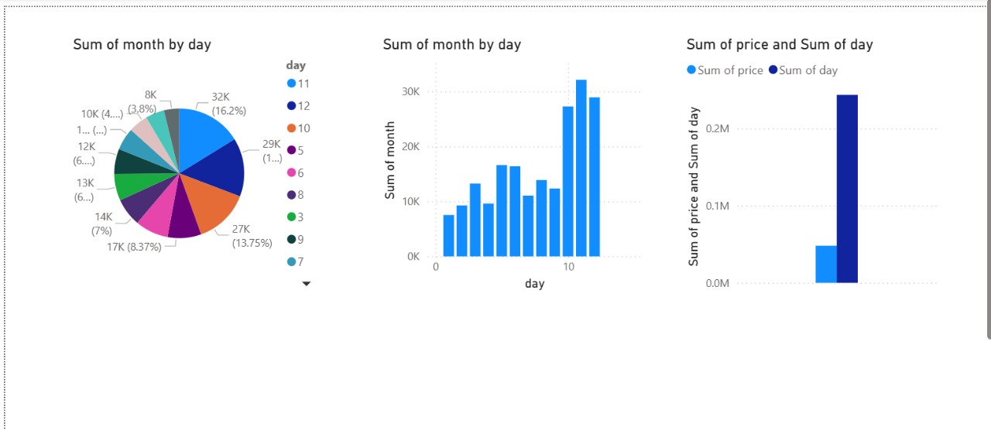
Visualization
Day 11 records the highest monthly sales contribution (16%).
Sales peak mid-month, especially on days 10–12.
Business is driven by many small transactions over fewer high-value ones.

Slide 11
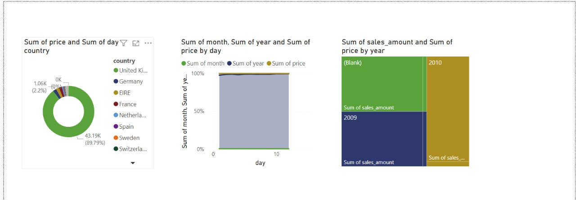
Visualization
Sales are dominated by the United Kingdom (~90%).
Year-wise sales trend dominates over month/day breakdowns.
2010 shows the highest sales, with missing year data indicating quality issues.

Slide 12
Conclusion
Successfully built a modern Data Lake Analytics Pipeline on Azure.
Automated workflows ensure scalable and repeatable processes.
Data transformations improved data quality and consistency.
Gold datasets provide business-ready insights.
Power BI dashboards enable real-time decision-making.

Slide 13
Thank you

